Slide 1
MDT – Malt deployment toolkit
Phil Schwan
Solution Architect
Netrix LLC
Fred Bainbridge
Senior Consultant
NowMicro

Slide 2
Phil Schwan
Fred Bainbridge
@philschwan
@FredBainbridge
MCSE: Enterprise Devices & Apps, Mobility
Awards, accomplishments, etc.
Almost 20 years desktop engineering
Experience
Running and Brewing FTW
Favorite something; e.g., food

Slide 3
agenda

Slide 4
agenda
Basics of Brewing
Ingredients
Process
Equipment

Slide 5
Brewing Basics
How does this all work?

Slide 6
Basics
Water
Grain
Yeast
Fermentation

Slide 7
Brewing Tips and Tricks
How does do I not screw this up?

Slide 8
Brewing Automation
IoT - Intoxication of Things?

Slide 10


Slide 11
agenda

Slide 12
Title
Line1
Bullet Level 1
Bullet Level 2
Bullet Level 3

Slide 13
Title
Code

Slide 14
Text Only with Border
Level 1
Level 2
Level 3

Slide 15
Text Only (Red)
Level 1
Level 2
Level 3

Slide 16
Title
Text 1
Level 1
Level 2
Level 3
Text 2
Level 1
Level 2
Level 3

Slide 17
Title
Section 1
Section 2
Text
Level 1
Level 2
Level 3
Text
Level 1
Level 2
Level 3

Slide 18
Demo Title

Slide 19





























Slide 20






























Slide 21




























Slide 22

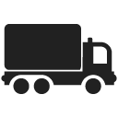


























Slide 23





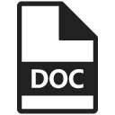
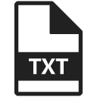




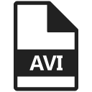

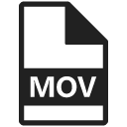




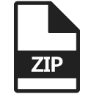
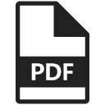








Slide 24





















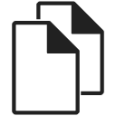






Slide 25




























Slide 26























Slide 27


